Slide 1

PYTHON INTERNSHIP mini PROJECT
TOPIC - Sports Tournament Scheduler

Slide 2
PROBLEM STATEMENT
Problem 156: Sports Tournament Scheduler POC:
• CRUD: Tournament data.
• automate_match_scheduling(tournament_id): Automatically schedule matches based on teams and available dates.
• generate_tournament_brackets(bracket_data): Generate and manage tournament brackets.
Code:
In this solution, we'll create a simple Sports Tournament Scheduler Proof of Concept (POC) in Python.
We'll organize the code into different classes for managing tournaments, teams, and the match scheduling logic.
We'll also implement data structures to handle operations efficiently and create unit tests.
Here's the outline:
1. Define classes for Tournament and Teams with relevant CRUD operations.
2. Implement functionality to automate match scheduling.
3. Generate and handle tournament brackets.
4. Write unit tests to verify functionality.

Slide 3
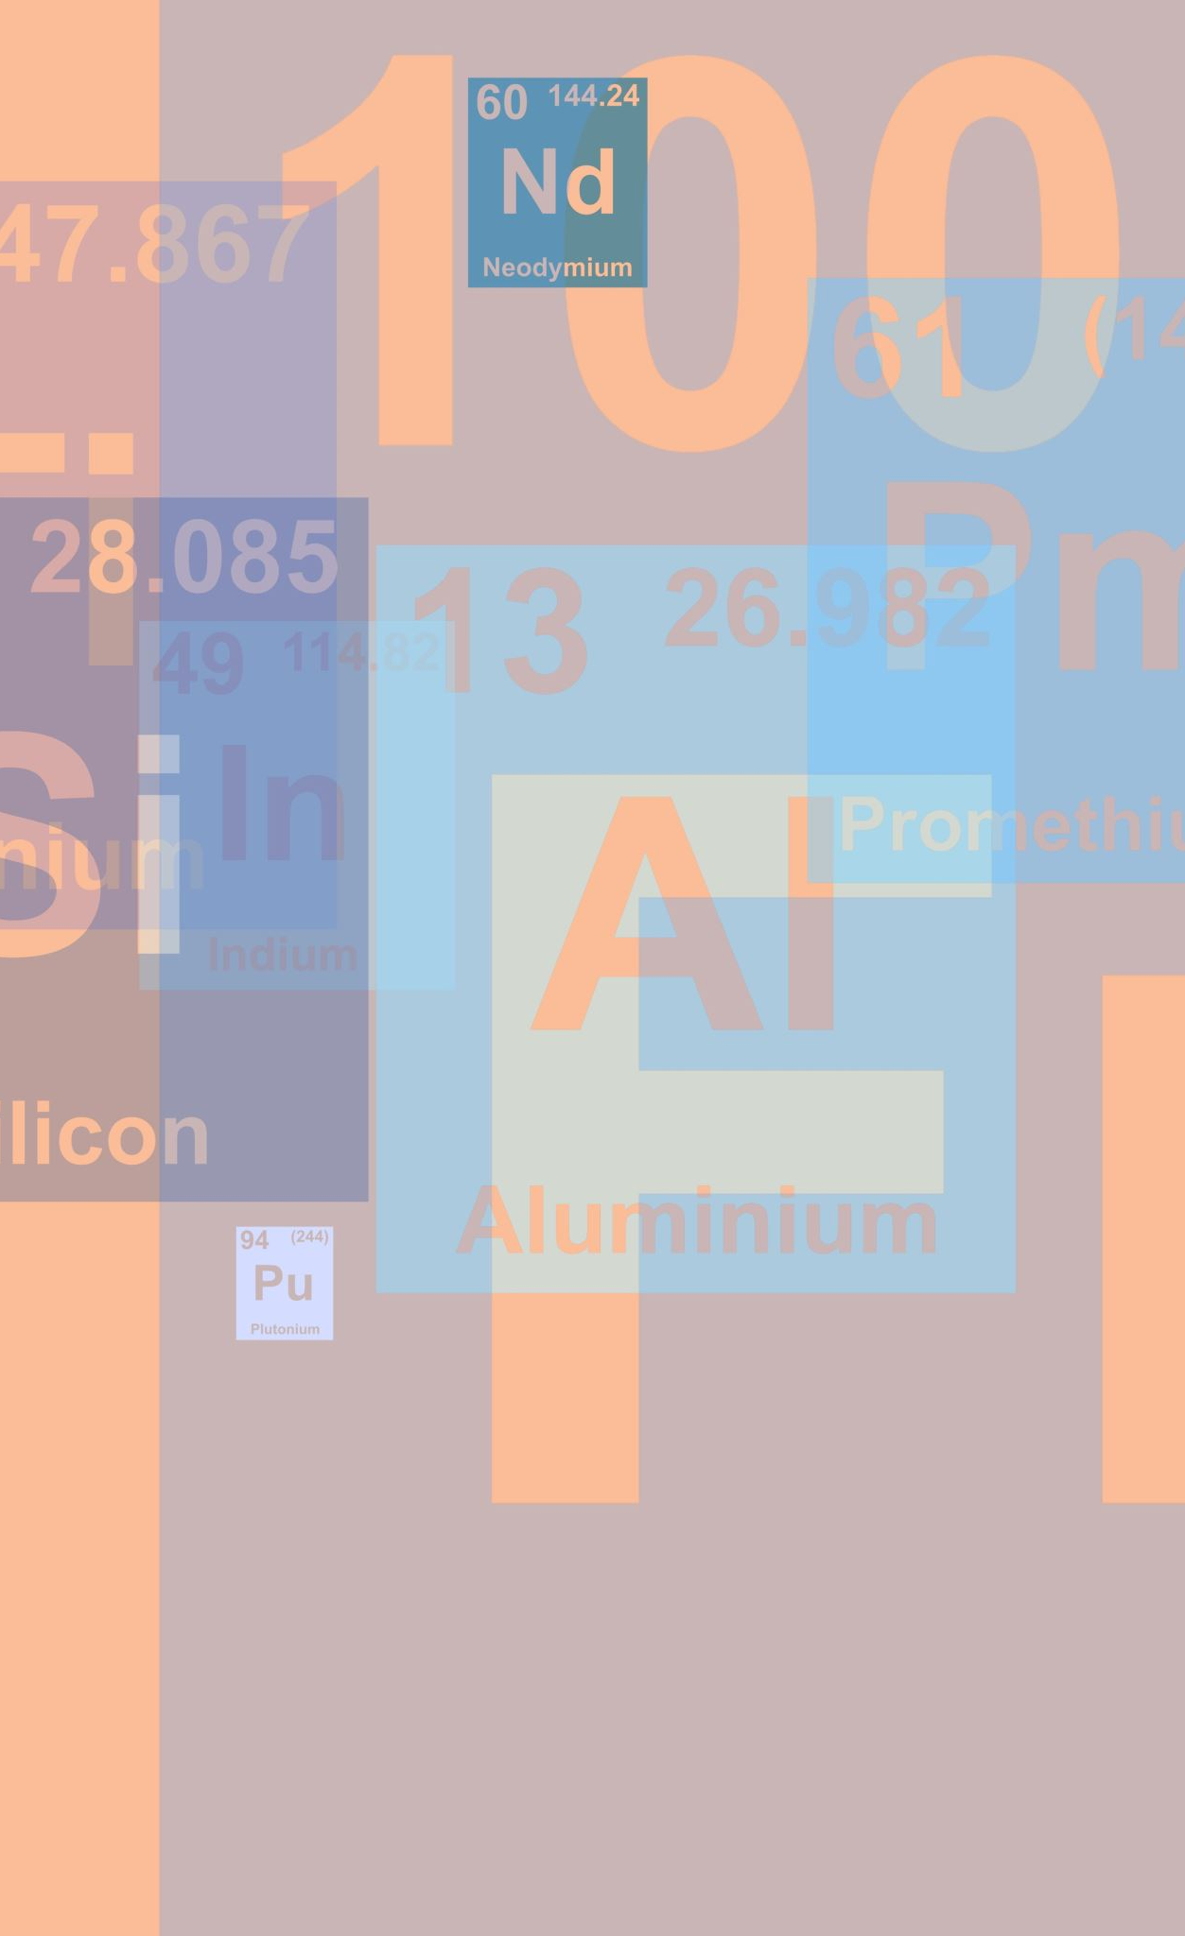
TEAM DETAILS
Team name : Coders
Team no : 17
Project no:156
Team members :
Yuvaraj Kumar M – 3BR22CS189
Vrishab M – 3BR22CS183
Shreya Y P – 3BR22CS157
Vaishnavi Joshi – 3BR22CS178

Slide 4
ABSTRACT
Abstract: The Sports Tournament Scheduler POC is a Python-based solution designed to streamline sports event scheduling. In this proof of concept, we focus on creating a robust system for managing tournaments, teams, and match scheduling. The key components include:
Tournament and Team Management:
We define classes to handle tournament data, allowing for CRUD (Create, Read, Update, Delete) operations. Teams are organized efficiently, ensuring accurate representation within the system.
Automated Match Scheduling:
Our solution automates match scheduling based on team availability and available dates. By intelligently assigning teams to timeslots, we optimize the overall tournament schedule.

Slide 5
ABSTRACT
Tournament Brackets:
We generate and manage tournament brackets, ensuring fair matchups and smooth progression through various rounds.
The bracket system facilitates tracking team progress and determining winners.
Unit Testing:
Rigorous unit tests validate the functionality of our solution.
We verify that CRUD operations, match scheduling, and bracket generation work as expected.

Slide 6
INTRODUCTION TO PROJECT
PROJECT NAME - SPORTS TOURNAMENT MANAGEMENT
CRUD operations in class Tournament and class Team.
Schedule matches automatically
Generate tournament brackets for particular matches.

Slide 7



MODULE DESCRIPTION
Test case 1 -
Test case 2 -
Test case 3 -

Slide 8



MODULE DESCRIPTION
Test case 4 -
Test case 5 -
Test case main -

Slide 9

CODE DESCRIPTION
Tournament chosen – Indian Premier League 2024
class Team includes the team_id and name
class Tournament includes the tournament_id, name and teams where CRUD operations are executed
add_team
remove_team
update_team
get_team

Slide 10
CODE DESCRIPTION
Used import itertools - Itertools is a module in Python's standard library that provides various functions for creating and manipulating iterators.
Enumerate is a built-in function in python that allows you to keep track of the number of iterations (loops) in a loop
class MatchScheduler is used to schedule matches for nine teams of IPL ie 1 match at a time.
In class MatchScheduler CRUD operations are performed to automate the match scheduler and to get match schedule.

Slide 11
CODE DESCRIPTION
Used class TournamentBrackets to allot some points to the matches.
For every match 3 tournament brackets are gained.
This class contains a built-in function called round().
It will return a float number that has been rounded to the decimal places specified as input.
CRUD operations are performed to generate and update tournament brackets.

Slide 12
CODE DESCRIPTION
Used import unittest Module:
Python provides the built-in unittest module for creating and running unit tests.
The unittest module follows the xUnit style framework and is inspired by JUnit.
It supports test automation, setup and teardown code sharing, test aggregation, and reporting.

Slide 13
CODE DESCRIPTION
Used class IPLTournament to setup the teams.
Test function using CRUD operations ie:
Test_add_team
Test_remove_team
Test_update_team
Where the teams are added and removed and updated based on unittest operations.

Slide 14
CODE DESCRIPTION
Used class IPLMatchScheduler where the test_automate_match_scheduling is performed to automate the match schedules i.e 1 match per day.
Used class IPLTournamentBrackets where test case test_generate_tournament_brackets is used to generate tournament brackets i.e 3 tournament brackets for each match.
In Python unit tests, setting verbosity=2 means that the test runner will display detailed information about each test, including the help string of every test and the result.
It provides a more verbose output compared to lower verbosity levels.

Slide 15
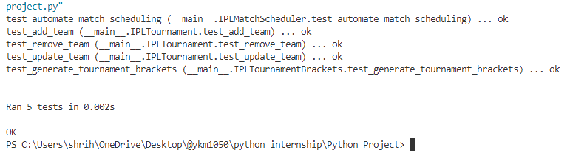
RESULTS AND DESCRIPTIONS
Unit test function output

Slide 16
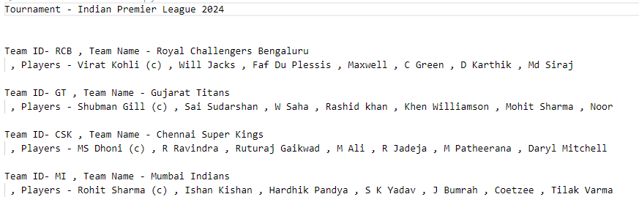
RESULTS AND DESCRIPTIONS
OUTPUT : stored in file - .csv, .json, .txt

Slide 17
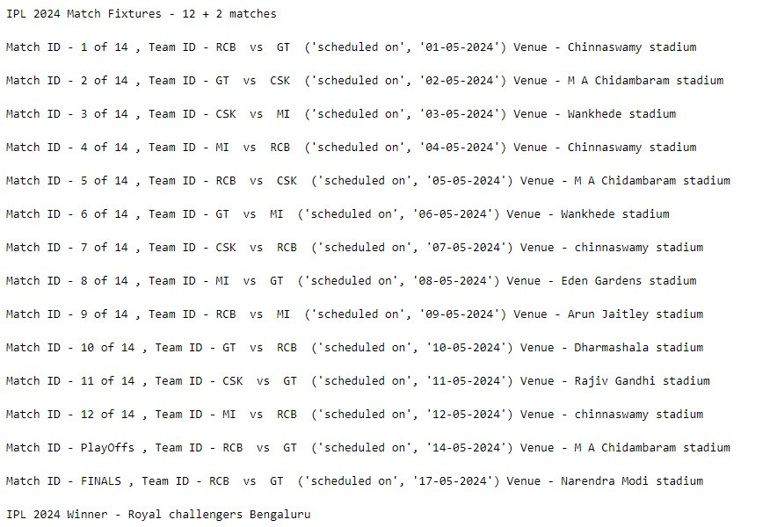
RESULTS AND DESCRIPTIONS

Slide 18
REFERENCES
LINKS :
Data Structures & Algorithms Textbook, IIT Bombay – by Narasimha Karumanchi
Microsoft Copilot - https://www.bing.com/chat?q=Microsoft+Copilot&FORM=hpcodx
Blackbox AI - https://www.blackbox.ai/
Geeks for Geeks - https://www.geeksforgeeks.org/unit-testing-python-unittest/
Git hub accounts :
https://github.com/ykm1050
https://github.com/Vrishab04
https://github.com/vaishnavijoshi2
https://github.com/shreyayp

Slide 19
THANK YOU
- From Team - Coders

